Slide 1


01
PROBLEM STATEMENT
TEAM 02
02
UTILIZING NLP AND DEEP LEARNING TO DETECT DEPRESSION IN SOCIAL MEDIA TEXTS
MOTIVATION
03
LITERATURE REVIEWS
04
DATASETS & TOOLS
05
EXPLORATORY DATA ANALYSIS
06
METHODOLOGY
07
FINAL EVALUATION
Koh Pei Ling, Song Yu Xiang, Lye Jian Yi, Evelyn Peh, Lau Wei Ting, Luqman Juzaili
08
CONCLUSION

Slide 2
CONTENT
01
PROBLEM STATEMENT
02
MOTIVATION
03
LITERATURE REVIEWS
04
DATASETS & TOOLS
05
EXPLORATORY DATA ANALYSIS
06
METHODOLOGY
07
FINAL EVALUATION
08
CONCLUSION

Slide 3

PROBLEM STATEMENT
Aim to predict whether one is suffering from depression through social media. Early prediction allows rapid intervention to ensure that their health condition will not escalate to the suicides
"Impacting an estimate of 300 million people"
Problem Statement
Motivation
Literature Review
Datasets & Tools
EDA
Methodology
Final Evaluation
Future Works

Slide 4




MOTIVATION
SUICIDAL RATES
Youths aged 10 to 29 remain the highest
increase from 22.3% in 2020 to 29.6% in 2021
COMMON STRESSORS
Interpersonal relationships, academic stress, achievement, career, finance
MULTIPLE EPISODES
SOCIAL MEDIA IS THE "NEW" SPACE
May only occur once, but people typically have multiple episodes
Early prediction and detection can prevent these episodes or suicide cases from happening
Social media plays a huge part in people's life
Turn to social media to vent and not receive feedback
Problem Statement
Motivation
Literature Review
Datasets & Tools
EDA
Methodology
Final Evaluation
Future Works

Slide 5

LITERATURE REVIEW SUMMARY
Reason for Twitter Dataset
Literature Review 1
Possible Adaptations / Improvements
Literature Review 2
Textual-based approach
Literature Review 3
Deep Learning
Literature Review 4
Handling Emojis
Literature Review 5
Word Embedding
Problem Statement
Motivation
Literature Review
Datasets & Tools
EDA
Methodology
Final Evaluation
Future Works

Slide 6





"SADFISHING"?
Refers to emotional posts where people express their vulnerability through social media
LITERATURE REVIEW 1
(1) Seeking Attention
(2) As a form of therapy
SADFISHING OF #JUSTICEFORAUDREY (HASHTAG) ON TWITTER
Problem Statement
Motivation
Literature Review
Datasets & Tools
EDA
Methodology
Final Evaluation
Future Works

Slide 7





Train
Test
LITERATURE REVIEW 2
Labeled Twitter Datasets
Depression-only Datasets
A TEXTUAL-BASED FEATURING APPROACH FOR DEPRESSION DETECTION USING MACHINE LEARNING CLASSIFIERS AND SOCIAL MEDIA TEXTS
Removed words like "Depression" and "Diagnosis"
Handling Imbalance Dataset
Remove relevant terms from twitter dataset
Over-Sampling Under-Sampling
Improve Accuracy Depression-Only Dataset
Improve Accuracy for Depression Label
Problem Statement
Motivation
Literature Review
Datasets & Tools
EDA
Methodology
Final Evaluation
Future Works

Slide 8
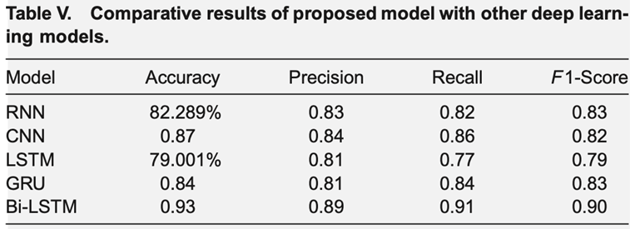
Deep Learning Model to Classify Tweets
RNN, CNN, LSTM, GRU and BiLSTM
Bi-LSTM model for depression classification outperformed the similar Deep Learning Models
LSTM is able to capture both semantic and syntactic information present in datasets
Only able to preserve the past information
Unable to utilise the future context
LITERATURE REVIEW 3
The others can only retain contextual information for a short period of time
DEEP LEARNING TECHNIQUES FOR DEPRESSION CLASSIFICATION IN SOCIAL MEDIA TEXT
With BiLSTM, both past and future context can be taken into consideration
Problem Statement
Motivation
Literature Review
Datasets & Tools
EDA
Methodology
Final Evaluation
Future Works

Slide 9
Overview
Use of emojis could potentially contribute the overall sentiment of a message
Retaining Emojis Semantics in NLP Tasks
LITERATURE REVIEW 4
Tokenization - Act of breaking up sequence of strings
Parts of Speech - Assigning a label to each token to reflect a word class
Sentiment Analysis - Understand the sentiment effect emojis have on textual communications
ASSESSING EMOJI USE IN MODERN TEXT PROCESSING TOOLS
Takeaways
Emojis should be considered when conducting sentiment analysis
Better understanding of signs of depression in social posts
Problem Statement
Motivation
Literature Review
Datasets & Tools
EDA
Methodology
Final Evaluation
Future Works

Slide 10
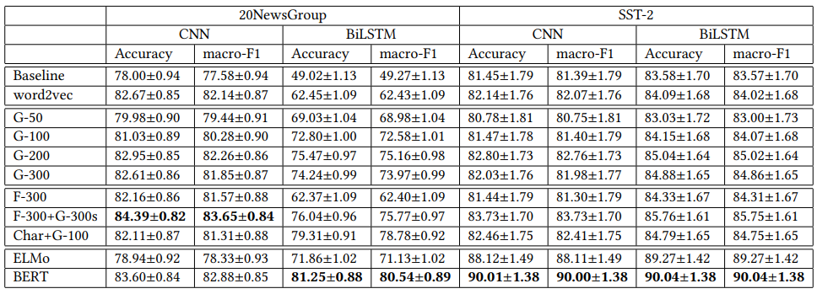
Word Embedding Techniques
Word2Vec, GloVe, FastText, Character-Level Embedding, ELMo, BERT
Key Takeaways
LITERATURE REVIEW 5
BERT yields the best performance
Able to capture the nuances and complexities of language in a way that traditional word embedding methods
Interesting to apply these embedding techniques with traditional ML methods, such as Naïve Bayes, SVM, etc.
A COMPARATIVE STUDY ON WORD EMBEDDINGS IN DEEP LEARNING FOR TEXT CLASSIFICATION
Problem Statement
Motivation
Literature Review
Datasets & Tools
EDA
Methodology
Final Evaluation
Future Works

Slide 11

DATASET
Sentiment Analysis for Tweets
Depression: Twitter Data
This dataset comprises around 10.1k dataset extracted from Twitter.
It consists of 3 columns:
1) ID
2) Tweet
3) Labels (1- Depression, 0 - Non-Depression)
This datasets comprises around 20k data extracted from Twitter.
It consists of 5 columns:
1) Tweet
2) Post_date
3) Number of Retweets
4) Favourites
5) Labels
Problem Statement
Motivation
Literature Review
Datasets & Tools
EDA
Methodology
Final Evaluation
Future Works

Slide 12
TOOLS & RESOURCES
Data Exploration | Natural Language Toolkit | Modelling
Data Mining: numpy pandas Visualisation Matplotlib Seaborn WordCloud Python Imaging Library Freq Dist Regular Expression Python RE | StopWords Stem - Porter Stemmer, Lemmatizer, WordNet Tokenize - Word_Tokenize | RNN CNN LSTM Bi-LSTM
Data Mining: numpy pandas Visualisation Matplotlib Seaborn WordCloud Python Imaging Library Freq Dist Regular Expression Python RE | StopWords Stem - Porter Stemmer, Lemmatizer, WordNet Tokenize - Word_Tokenize | Evaluation
Data Mining: numpy pandas Visualisation Matplotlib Seaborn WordCloud Python Imaging Library Freq Dist Regular Expression Python RE | StopWords Stem - Porter Stemmer, Lemmatizer, WordNet Tokenize - Word_Tokenize | Sklearn.Metrics: Accuracy_Score Precision_Score Recall_Score F1_Score
Problem Statement
Motivation
Literature Review
Datasets & Tools
EDA
Methodology
Final Evaluation
Future Works

Slide 13
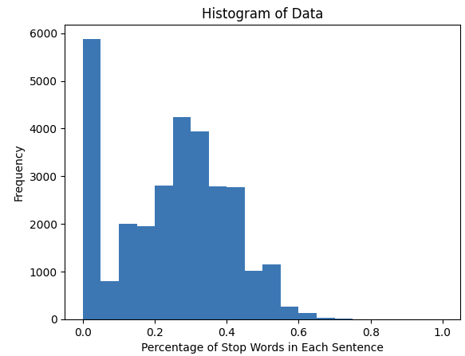
EDA - PERCENTAGE OF STOP WORDS
Stop words are usually filtered out and they are considered to be less informative than other words in the text.
The frequency of Stop Words in a sentence can indicate the quality of the text. For example, the high frequency of stop words, suggests that the text is poorly written, lacks focus or is ungrammatical.
From our dataset, most of the percentage of stop words falls between the 0.0 to 0.3 ranges, thus, it indicates that our dataset has a rather high text quality.
Problem Statement
Motivation
Literature Review
Datasets & Tools
EDA
Methodology
Final Evaluation
Future Works

Slide 14
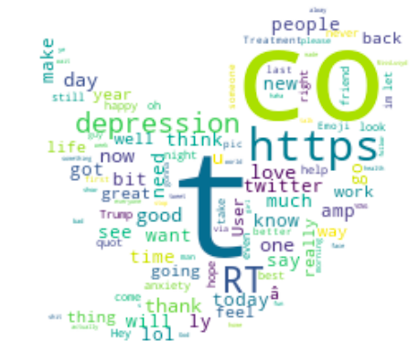
EDA - COMMON WORDS IN THE TWEET
From the Word Cloud, we can see that:
1) There are internet links (Eg. https protocol)
2) There are Contractions ( I'm, we're, he's)
3) There are Standalone Characters
4) There are short forms like (lol, ly - love you)
5) There are also Stop words (The, That, etc.)
However, this is not exhaustive, and we need a closer inspection of the dataset with sampling.
Problem Statement
Motivation
Literature Review
Datasets & Tools
EDA
Methodology
Final Evaluation
Future Works

Slide 15
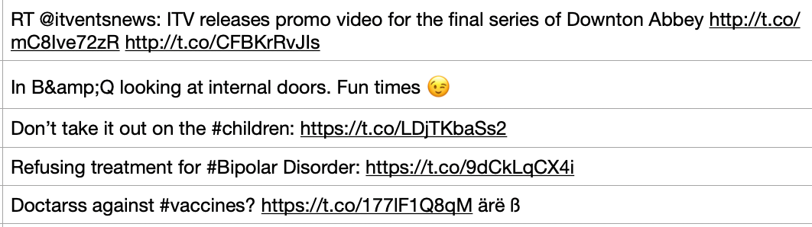
EDA - OTHER WORDS IN THE TWEET
Retweet/ Mentions of Users
HTML Entities
Hashtags
Emojis
Spelling Errors
Other variations of alphabets
From this, there is a need for us to further clean our dataset.
Problem Statement
Motivation
Literature Review
Datasets & Tools
EDA
Methodology
Final Evaluation
Future Works

Slide 16
CLEANING OF DATASET
1
2
3
4
Removal of HTML Entities
Conversion of Contractions to their full word form
Removal of Hastags
Removal of URL
5
6
7
8
Removal of Mentions/Retweets User Accounts
Removal of Punctuations
Emojis to textual description conversion
Removal of Numbers
9
10
11
Remove Stop Words
Tokenization
Lemmetization
Problem Statement
Motivation
Literature Review
Datasets & Tools
EDA
Methodology
Final Evaluation
Future Works

Slide 17



METHODOLOGY
Word
Embedding
Traditional
Classification
Classification
Report
Neural
Networks
Problem Statement
Motivation
Motivation
Literature Review
Literature Review
Datasets & Tools
EDA
EDA
Methodology
Methodology
Final Evaluation
Final Evaluation
Future Works
Problem Statement
Datasets & Tools
Future Works

Slide 18
METHODOLOGY
Language Model | Processing Method | Contextualised?
Word2Vec | Neural Network Based | No
ELMO | Two-layer bidirectional LSTM Network | Yes
GPT-2 | Unidirectional Transformer Based | Yes
BERT | Bi-Directional Transformer Based (Masked Langauge) | Yes
Problem Statement
Motivation
Motivation
Literature Review
Literature Review
Datasets & Tools
EDA
EDA
Methodology
Methodology
Final Evaluation
Final Evaluation
Future Works
Problem Statement
Datasets & Tools
Future Works

Slide 19
METHODOLOGY
Traditional Classifiers | Traditional Classifiers | Traditional Classifiers
Support Vector Machine | Works by finding the best hyperplane to classify data | Works by finding the best hyperplane to classify data
Gradient Boosting | Ensemble Method that combines multiple models to create strong predictor | Ensemble Method that combines multiple models to create strong predictor
Random Forest | Ensemble Method that uses multiple decision Tree to Classify Data, | Ensemble Method that uses multiple decision Tree to Classify Data,
Logistic Regression | Analyse the relationship between X and Y by estimating probabilities with logistic function | Analyse the relationship between X and Y by estimating probabilities with logistic function
Decision Tree | Using a tree to classify or predict outcomes | Using a tree to classify or predict outcomes
Gaussian Naives Bayes | A probabilistic algorithm that uses Bayes Therem and assumes features are indeopent and | A probabilistic algorithm that uses Bayes Therem and assumes features are indeopent and
Problem Statement
Motivation
Literature Review
Datasets & Tools
EDA
Methodology
Final Evaluation
Future Works

Slide 20
METHODOLOGY
Neural Networks | Neural Networks | Neural Networks
LSTM | Using memory cells and gates to selectively add or remove information from the memory, which also allows network to maintain information longer | Using memory cells and gates to selectively add or remove information from the memory, which also allows network to maintain information longer
Bi-LSTM | Extension of LSTM, works by processing data in both forward and backward direction, capture dependencies. | Extension of LSTM, works by processing data in both forward and backward direction, capture dependencies.
CNN | Works by identifying spatial patterns in the data by applying filters to subsets input data and aggregates them to create a more abstract representation. | Works by identifying spatial patterns in the data by applying filters to subsets input data and aggregates them to create a more abstract representation.
RNN | Works by maintaining a memory of previous inputs and uses it to inform prediction at each time step. | Works by maintaining a memory of previous inputs and uses it to inform prediction at each time step.
Problem Statement
Motivation
Literature Review
Datasets & Tools
EDA
Methodology
Final Evaluation
Future Works
Notes:
For script: remember to mention that for each deep learning model, we use the same model configuration for each word embedding pair. Fine tuning is too expensive (in terms of effort and time) so with the same model, we see which word embedding can perform best

Slide 21


WORD2VEC

Slide 22
WORD2VEC DEFINITION
It is a technique for generating dense, low-dimension vector representation of a word.
In addition, it learns word embeddings by predicting the context of the word of the neighbouring words. (Not the whole sentence)
Neural Network Based
Problem Statement
Motivation
Literature Review
Datasets & Tools
EDA
Methodology
Final Evaluation
Future Works

Slide 23
WORD2VEC
Continuous Bag of Words (CBOW)
Skip-Gram
The | quick | ? | fox | jumps
? | ? | brown | ? | ?
brown
The | quick
fox | jumps
Predicting target word from context
Predicting context word from target
Problem Statement
Motivation
Literature Review
Datasets & Tools
EDA
Methodology
Final Evaluation
Future Works

Slide 24

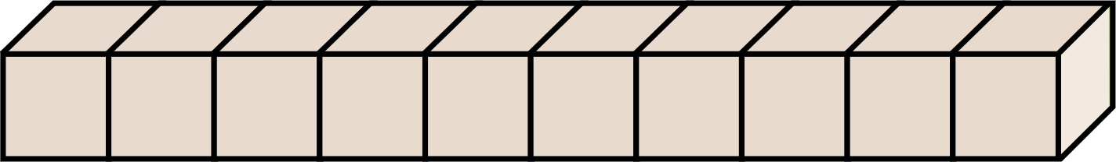
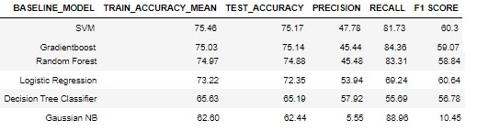
TRADITIONAL CLASSIFIERS
Text Tokenization
Train Word2Vector Model
Train Test Split
Obtain Vector Representation
Traditional Classifiers
Problem Statement
Motivation
Literature Review
Datasets & Tools
EDA
Methodology
Final Evaluation
Future Works

Slide 25
DEEP LEARNING MODELS
Text Tokenization
Train Word2Vector Model
Train Test Split
Obtain Vector Representation
Training
Deep Learning Layers
Model Validation
Prediction
Problem Statement
Motivation
Literature Review
Datasets & Tools
EDA
Methodology
Final Evaluation
Future Works

Slide 26
TEST RESULTS
 | Accuracy | Precision | Recall | F1-Score
SVM | 75.17 | 47.78 | 81.73 | 60.3
GB | 75.14 | 45.44 | 84.30 | 59.07
RF | 74.88 | 45.48 | 83.31 | 58.84
LR | 72.35 | 53.94 | 69.24 | 60.64
DT | 65.19 | 57.92 | 55.69 | 58.78
G-NB | 62.44 | 5.55 | 88.96 | 10.45
 | Accuracy | Precision | Recall | F1-Score
RNN | 0.76 | 0.79 | 0.52 | 0.63
BI-LSTM | 0.76 | 0.76 | 0.56 | 0.64
LSTM | 0.76 | 0.84 | 0.50 | 0.63
CNN | 0.76 | 0.82 | 0.50 | 0.62
Problem Statement
Motivation
Literature Review
Datasets & Tools
EDA
Methodology
Final Evaluation
Future Works

Slide 27

EMBEDDINGS FROM LANGUAGE MODEL (ELMO)

Slide 28
ELMO DEFINITION
Processes the input sequence in both directions, allowing it to capture contextual information from both the preceding and following words.
Two-layer bidirectional LSTM Network
Problem Statement
Motivation
Literature Review
Datasets & Tools
EDA
Methodology
Final Evaluation
Future Works

Slide 29



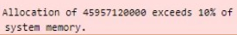
TRUNCATION OF DATASET
2500 Depressed Tweets
2500 Non-depressed Tweets
Memory Overload
Problem Statement
Motivation
Literature Review
Datasets & Tools
EDA
Methodology
Final Evaluation
Future Works

Slide 30
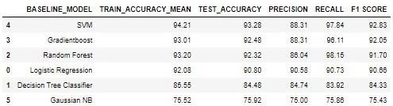
TRADITIONAL CLASSIFIERS
Subset of tweets
dataset
(5000 rows)
Dimensionality Reduction
(Max Pooling)
Train Test Split
ELMo Embeddings
Traditional Classifiers
Problem Statement
Motivation
Literature Review
Datasets & Tools
EDA
Methodology
Final Evaluation
Future Works

Slide 31
DEEP LEARNING MODELS
Subset of tweets
dataset (5000 rows)
Embeddings with
ELMo M﻿odel
Train Validation
Test Split
Training
Deep Learning
Layers
Model Validation
Prediction
Problem Statement
Motivation
Literature Review
Datasets & Tools
EDA
Methodology
Final Evaluation
Future Works

Slide 32
TEST RESULTS
 | Accuracy | Precision | Recall | F1-Score
SVM | 93.28 | 88.31 | 97.84 | 92.83
GB | 92.48 | 88.31 | 96.11 | 92.05
RF | 92.32 | 86.04 | 98.15 | 91.70
LR | 90.80 | 90.58 | 90.73 | 90.66
DT | 84.48 | 84.74 | 83.92 | 84.33
G-NB | 75.92 | 75.00 | 75.86 | 75.43
 | Accuracy | Precision | Recall | F1-Score
BI-LSTM | 0.93 | 0.96 | 0.89 | 0.92
RNN | 0.92 | 0.94 | 0.89 | 0.92
CNN | 0.92 | 0.93 | 0.91 | 0.92
LSTM | 0.92 | 0.98 | 0.87 | 0.92
Problem Statement
Motivation
Literature Review
Datasets & Tools
EDA
Methodology
Final Evaluation
Future Works
Notes:
The above table shows the evaluation result for both Traditional Classifiers and Deep Learning Models. Few key observations that can be made are that generally, the deep learning models were able to achieve a higher precision and accuracy score than the traditional classifier but not in the case for recall.
Since the focus of model evaluation is based on f1-score, it is fair to say that the deep learning models perform significantly better than the traditional classifiers as the former achieve significantly higher f1-score than the latter. These deep learning models poof to be able to improve performance significantly by having a longer training time.
Among the 9 models, RNN being able to yield the highest f1-score will be deemed as the best performing model for BERT embedding.

Slide 33

GENERATIVE PRE-TRAINED TRANSFORMER 2 (GPT2)

Slide 34
GPT2 DEFINITION
It processes input in a single direction and considers context that comes before the current position.
It also leverages the Transformer neural network architecture.
Uni-Directional Transformer Based
Problem Statement
Motivation
Literature Review
Datasets & Tools
EDA
Methodology
Final Evaluation
Future Works
Notes:
A unidirectional language model processes input text in a single direction, either left to right or right to left can only consider context that comes before the current position, it means it cannot directly capture dependencies between sentences that appear later in the document.

Slide 35
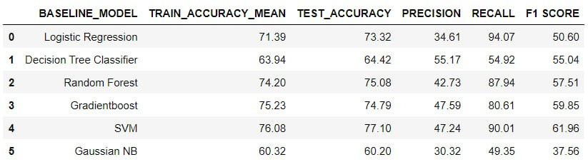
Traditional Classifiers
Tokenization with GPT2Tokenizer
Embedding with GPT2LMHeadModel
Train Test Split
GPT2 Embeddings
Traditional Classifiers
Problem Statement
Motivation
Literature Review
Datasets & Tools
EDA
Methodology
Final Evaluation
Future Works

Slide 36
Deep Learning Models
Tok﻿enization with GPT2Tokenizer
Embedding with GPT2LMHeadModel
GPT2 Embeddings
Training
Train ,Val, Test Split
Data preparation
Apply Deep Learning Layers
Model Validation
(Save Model with lowest validation loss)
Test and Prediction
Load Best Model
Problem Statement
Motivation
Literature Review
Datasets & Tools
EDA
Methodology
Final Evaluation
Future Works

Slide 37
TEST RESULTS
 | Accuracy | Precision | Recall | F1-Score
SVM | 77.10 | 47.24 | 90.01 | 61.96
GB | 74.79 | 47.59 | 80.61 | 59.85
RF | 75.08 | 42.73 | 87.94 | 57.51
LR | 73.32 | 34.61 | 94.07 | 50.60
DT | 64.42 | 55.17 | 54.92 | 55.04
G-NB | 60.20 | 30.32 | 49.35 | 37.56
 | Accuracy | Precision | Recall | F1-Score
RNN | 0.3948 | 0.3948 | 1.0 | 0.5661
BI-LSTM | 0.64 | 0.75 | 0.14 | 0.24
LSTM | 0.64 | 0.62 | 0.30 | 0.41
CNN | 0.75 | 0.80 | 0.48 | 0.60
Problem Statement
Motivation
Literature Review
Datasets & Tools
EDA
Methodology
Final Evaluation
Future Works

Slide 38

BIDIRECTIONAL ENCODER REPRESENTATIONS FROM TRANSFORMERS (BERT)

Slide 39
BERT DEFINITION
Different from the other Language models, BERT is masked language because some of the input tokens are randomly replaced with a special mask token, and the model is trained to predict the original value based on the context provided.
Bi-Directional Transformer Based (Masked Langauge)
Problem Statement
Motivation
Literature Review
Datasets & Tools
EDA
Methodology
Final Evaluation
Future Works

Slide 40
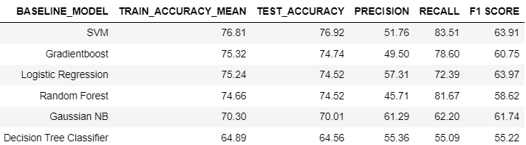

TRADITIONAL CLASSIFIERS
Tokenization with BertTokenizer
Embeddings with BertModel
Train Test Split
BERT Embeddings
Traditional Classifiers
Problem Statement
Motivation
Literature Review
Datasets & Tools
EDA
Methodology
Final Evaluation
Future Works
Notes:
Now I will be sharing an overview of the modeling process with bert embedding method.
Firstly, we leveraged on BertTokenizer from Hugging Face library to preprocess text data into a format that can be fed into the BertModel. Next, we pass the output into the pre-trained BertModel to generate contextualized word embeddings.
once the data is ready, we performed the usual step of splitting the data and then training the classification model and then finally getting prediction on the test data.
I would like to bring your focus to SVM and LR. We can see that Logistic Regression has a slightly higher f1-score than SVM. However, SVM has a significant higher Recall which was more important as the consequences of not being able to correctly identify someone with depression is much higher.
One possible reason why we think SVM is able to outperform other model is due to it finding the best hyperplane that separates the data points into different classes. The hyperplane is chosen to maximize the margin, which is the distance between the hyperplane and the nearest data points from each class, also called the support vectors. However, one trade-off is it usually takes longer to train the SVM model.

Slide 41
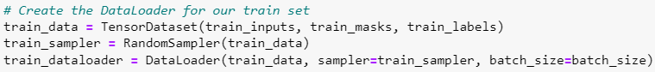
DEEP LEARNING MODELS
Tok﻿enization with BertTokenizer
Train Validation Test Split
Data preparation
Training
Embeddings with BertModel
Deep Learning Layers
Model Validation
(Save Model with lowest validation loss)
BERT Embeddings
Prediction
Load Best Model
Problem Statement
Motivation
Literature Review
Datasets & Tools
EDA
Methodology
Final Evaluation
Future Works
Notes:
For deep learning models, similarly, we will preprocess text data into a format that can be fed into the BertModel.
Next, we split the data into train, validate and test set and then prepare the data for training by using dataloader from pytorch
The dataloader loads data from the dataset in batches. this is necessary because In deep learning, large datasets are often used to train models, and these datasets can be too large to fit in memory all at once. Therefore, to address this issue, the Dataloaders provide a way to load data in batches, allowing for efficient use of memory during training.
During each training epoch, the model is presented with batches of input examples which will be passed through the BERTModel to generate Embeddings and then fed into the deep learning layers
In each epochs, we will also test the model against the validation set and the final model that will be applied to the test set will be the one the yield the best performance on a held-out validation dataset. In this case, we define best performance as the one with the lowest validation loss.
lastly, we will load the best model and perform prediction

Slide 42
TEST RESULTS
 | Accuracy | Precision | Recall | F1-Score
LR | 0.75 | 0.57 | 0.72 | 0.64
SVM | 0.77 | 0.53 | 0.84 | 0.64
G-NB | 0.70 | 0.61 | 0.62 | 0.62
GB | 0.75 | 0.50 | 0.79 | 0.61
RF | 0.75 | 0.46 | 0.82 | 0.59
DT | 0.65 | 0.55 | 0.55 | 0.55
 | Accuracy | Precision | Recall | F1-Score
RNN | 0.78 | 0.73 | 0.73 | 0.73
CNN | 0.80 | 0.77 | 0.68 | 0.72
BI-LSTM | 0.80 | 0.79 | 0.69 | 0.74
LSTM | 0.80 | 0.78 | 0.70 | 0.74
Problem Statement
Motivation
Literature Review
Datasets & Tools
EDA
Methodology
Final Evaluation
Future Works

Slide 43
F1-Sc﻿ore
F1-Score is a combined measure that is derived from Precision (P) and Recall (R)
Also known as the Weighted Harmonic Mean, it is useful for balancing the tradeoff between precision and recall, to find the overall perfomance score for the classification model
WHICH METRICS DID WE FOCUS ON?
Recall
Recall answers the question: When it's actually positive, how often does it predict positive?
We used it as our cost of False Negative is high (When the person have been diagnosed with depression, but it was not detected)
F1 SCORE
F1 SCORE = 2PR / (P + R)
Precision
RECALL
Precision answers the question: When it predicts positive, how often is it correct?
It is a good measure to use when the costs of False Positive is high Eg. Spam Detection
TP = TP / (TP + FP)
RECALL = TP / (TP + FN)
Problem Statement
Motivation
Literature Review
Datasets & Tools
EDA
Methodology
Final Evaluation
Future Works

Slide 44

BEST OF EACH WORD EMBEDDING
 | Accuracy | Precision | Recall | F1-Score
GPT + SVM | 0.77 | 0.47 | 0.90 | 0.62
Word2Vec + Bi-LSTM | 0.76 | 0.76 | 0.56 | 0.64
ELMO + SVM | 0.93 | 0.88 | 0.98 | 0.93
BERT + RNN | 0.78 | 0.73 | 0.73 | 0.73
Problem Statement
Motivation
Literature Review
Datasets & Tools
EDA
Methodology
Final Evaluation
Future Works

Slide 45
FINAL EVALUATION
ELMo works well with most Deep Learning Models as they capture rich, context-dependent information about each word in the text, using a bidirectional network (explained previously), unlike traditional word embeddings.
The contextualized information captured by ELMo embeddings can help to address the problem of polysemy, where a word can have multiple meanings depending on the context in which it appears.
For our implementation, we have tested and trained it with randomized sample data to account for the small sample that we used (due to the lack of memory allocation)
Hence, it would work best even when we scale the size of the dataset.
Therefore, as the sample is only about 20% of the full data, we cannot be 100% sure that ELMo + SVM will be the eventual best performer and have settled for BERT + RNN as the final best combination.
Problem Statement
Motivation
Literature Review
Datasets & Tools
EDA
Methodology
Final Evaluation
Future Works

Slide 46


FUTURE WORKS
ELMo Embedding
Model Deployment
More Datapoints
Collate dataset from different platforms like Reddit, Youtube comments, Instagram comments to have more accurate and inclusive prediction of depressive sentiments
(for Doc2Vec & TopicModelling implementation)
Deploy the top-performing Machine Learning or Deep Learning algorithms into a web application for the public to identify if a tweet is depressive or not
(Preventive Action)
Run ELMo embeddings on the entire dataset with the using of Cache (AWS S3 Bucket) to see the actual accuracies of ELMo output on the dataset
Problem Statement
Motivation
Literature Review
Datasets & Tools
EDA
Methodology
Final Evaluation
Future Works

Slide 47

THANK YOU!
ANY QUESTIONS?

Slide 48
REFERENCES (1)
https://chat.openai.com/chat
https://www.sos.org.sg/pressroom/singapores-suicide-rates-decrease-yet-rising-youth-numbers-cause-for-concern#:~:text=Suicide%2C%20however%2C%20remains%20the%20cause,suicides%20recorded%20across%20the%20nation
Fox, M. (2018, July 31). Depressed teens turn to social media to cope, survey finds. NBCNews.com. Retrieved February 18, 2023, from https://www.nbcnews.com/health/health-news/depressed-teens-turn-social-media-cope-survey-finds-n895951
Putri, Citra & Damayanti, Novita & Hamzah, Radja. (2020). Sadfishing Phenomenon of #Justiceforaudrey (Hashtag) on Twitter. Mediator: Jurnal Komunikasi. 13. 10.29313/mediator.v13i1.5598.
Raymond Chiong, Gregorius Satia Budhi, Sandeep Dhakal, Fabian Chiong, A textual-based featuring approach for depression detection using machine learning classifiers and social media texts, Computers in Biology and Medicine, Volume 135, 2021,104499, ISSN 0010-4825, https://doi.org/10.1016/j.compbiomed.2021.104499.
Shoeb, A. A. M., & de Melo, G. (2021). Assessing emoji use in modern text processing tools. arXiv preprint arXiv:2101.00430.
Farruque, N., Zaïane, O. R., Goebel, R., & Sivapalan, S. (2022, May). DeepBlues@ LT-EDI-ACL2022: Depression level detection modelling through domain specific BERT and short text depression classifiers. In Proceedings of the Second Workshop on Language Technology for Equality, Diversity and Inclusion (pp. 167-171).

Slide 49
REFERENCES (2)
The Healthline Editorial Team. (2019, October 15). Why teens turn to 'sadfishing' on social media. Healthline. Retrieved February 18, 2023, from https://www.healthline.com/health-news/why-teens-turn-to-sadfishing-on-social-media
Ahmad, Hussain & Asghar, Dr. Muhammad & Alotaibi, Fahad & Hameed, Ibrahim. (2020). Applying Deep Learning Technique for Depression Classification in Social Media Text. Journal of Medical Imaging and Health Informatics. 10. pp. 2446-2451(6). 10.1166/jmihi.2020.3169.
Dataquest. (2023, February 8). How to clean and analyze your data, using feedback of student projects. Dataquest. Retrieved February 18, 2023, from https://www.dataquest.io/blog/how-to-clean-and-prepare-your-data-for-analysis/
https://www.youtube.com/watch?v=xMQG0iRSjHw
https://stackoverflow.com/questions/57679668/tokenizing-emojis-contiguous-to-words
https://www.kaggle.com/code/shahules/basic-eda-cleaning-and-glove
https://www.kaggle.com/code/ardawrld/twitter-sentiment-analysis-about-the-depression
Doshi, S. (2019, March 5). Twitter sentiment analysis using fasttext. Medium. Retrieved February 18, 2023, from https://towardsdatascience.com/twitter-sentiment-analysis-using-fasttext-9ccd04465597#:~:text=Replace%20any%20emojis%20with%20the,Remove%20punctuations.

Slide 50
REFERENCES (3)

